Slide 1


GO! with Microsoft 365®
Excel 2025 Edition
Chapter 2
Using Functions, Creating Tables, and Managing Large Workbooks
Copyright © 2026, 2023, 2020 Pearson Education, Inc. All Rights Reserved
Notes:
If this PowerPoint presentation contains mathematical equations, you may need to check that your computer has the following installed:
1) Math Type Plugin
2) Math Player (free versions available)
3) NVDA Reader (free versions available)
GO! With Microsoft 365
Excel 2025 Edition
Chapter 2: Using Functions, Creating Tables, and Managing Large Workbooks

Slide 2
Learning Objectives (1 of 2)
2.1 Use Flash Fill and the SUM, AVERAGE, MEDIAN, MIN, and MAX Functions
2.2 Move Data, Resolve Error Messages, and Rotate Text
2.3 Use COUNTIF and IF Functions and Apply Conditional Formatting
2.4 Use Date & Time Functions and Freeze Panes
2.5 Create, Sort, and Filter an Excel Table
2.6 View, Format, and Print a Large Worksheet
Notes:
The objectives of this chapter are:
Use Flash Fill and the SUM, AVERAGE, MEDIAN, MIN, and MAX Functions
Move Data, Resolve Error Messages, and Rotate Text
Use COUNTIF and IF Functions and Apply Conditional Formatting
Use Date & Time Functions and Freeze Panes
Create, Sort, and Filter an Excel Table
View, Format, and Print a Large Worksheet

Slide 3
Learning Objectives (2 of 2)
2.7 Navigate a Workbook and Rename Worksheets
2.8 Enter Dates, Clear Contents, and Clear Formats
2.9 Copy and Paste by Using the Paste Options Gallery
2.10 Edit and Format Multiple Worksheets at the Same Time
2.11 Create a Summary Sheet with Column Sparklines
2.12 Format and Print Multiple Worksheets in a Workbook
Notes:
Additional objectives of this chapter are:
Navigate a Workbook and Rename Worksheets
Enter Dates, Clear Contents, and Clear Formats
Copy and Paste by Using the Paste Options Gallery
Edit and Format Multiple Worksheets at the Same Time
Create a Summary Sheet with Column Sparklines
Format and Print Multiple Worksheets in a Workbook

Slide 4
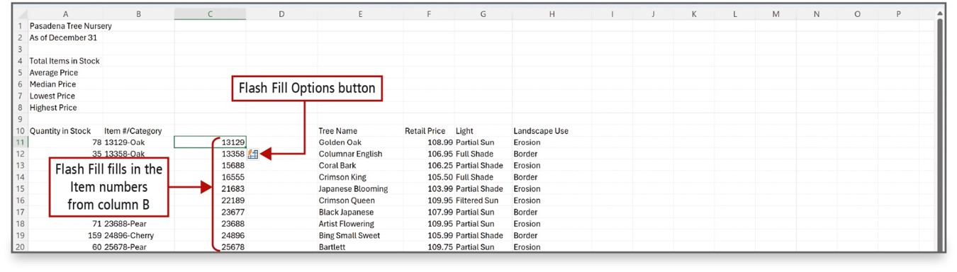
Use Flash Fill and the SUM, AVERAGE, MEDIAN, MIN, and MAX Functions (1 of 5)
Notes:
Flash Fill recognizes a pattern in your data, and then automatically fills in values when you enter examples of the output that you want.
A function is a predefined formula.
Statistical functions include AVERAGE, MEDIAN, MIN, and MAX functions.
Long Description:
An inventory table has column headers as Quantity in Stock, Item has or Category, Tree Name, Retail Price, Light, and Landscape Use. A callout pointing to a pop-up button near an entry in column C reads, Flash Fill Options button. A callout pointing to the entries under column C reads, Flash Fill fills in the Item numbers from column B.

Slide 5
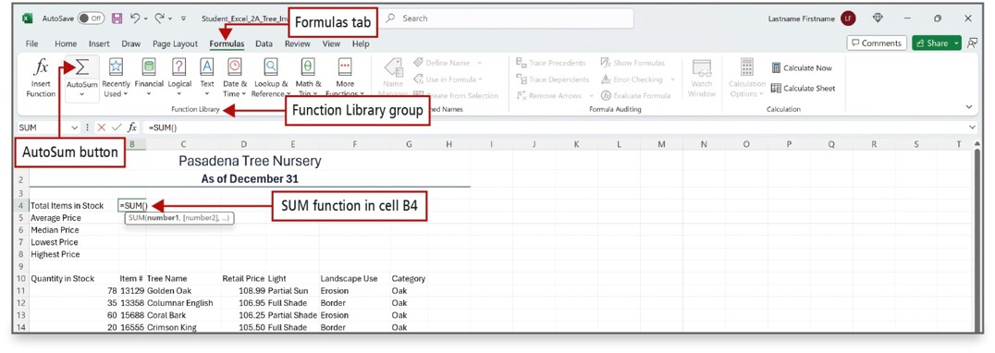
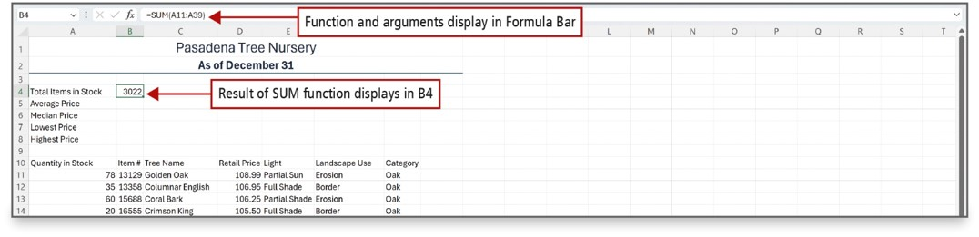
Use Flash Fill and the SUM, AVERAGE, MEDIAN, MIN, and MAX Functions (2 of 5)
Notes:
The SUM function is a predefined formula that adds all the numbers in a selected range of cells. You can insert the SUM function from the Home tab, from the Formulas tab, or by using the keyboard shortcut, Alt + =.
Long Description 1:
Long description: Callouts point to the AutoSum button, Function Library group, Formulas tab. A table has column headers as Quantity in Stock, Item has or Category, Tree Name, Retail Price, Light, Landscape Use, and Category. Above them are rows for Total Items in Stock, Average Price, Median Price, Lowest Price, and Highest Price. The SUM formula is typed for Total Items in Stock. The corresponding callout reads, SUM function in cell B 4.
Long Description 2:
Long description: The formula in the formula bar reads, equals SUM open parenthesis A 11 is to A 39 close parenthesis. A callout pointing to the SUM function in the formula bar reads, function and arguments display in formula bar. Another one pointing to cell B 4 entered for Total Items in Stock reads, result of the SUM function.

Slide 6
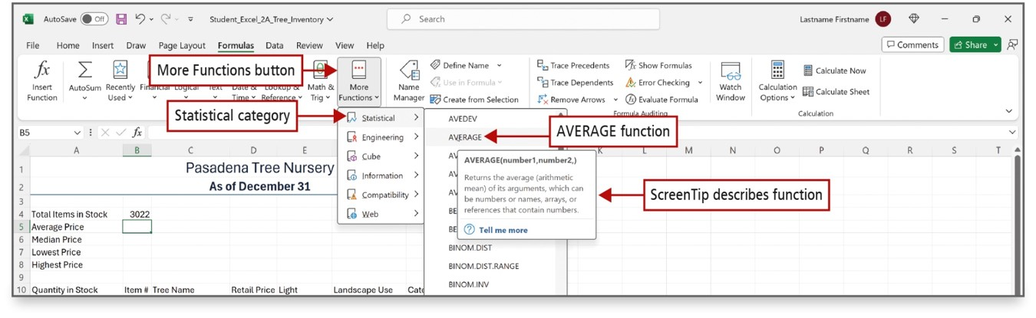
Use Flash Fill and the SUM, AVERAGE, MEDIAN, MIN, and MAX Functions (3 of 5)
Notes:
The More Functions button on the Formulas tab offers many function options, including the AVERAGE function, as shown here.
The AVERAGE function adds a group of values and then divides the result by the number of values in the group.
Long Description:
The Formulas tab is selected. The More Functions menu has options such as Statistical, Engineering, Cube, Information, Compatibility, and Web. A submenu from Statistical has functions such as AVEDEC, AVERAGE, and so on. A ScreenTip over AVERAGE reads, AVERAGE open parenthesis number 1 comma number 2 comma close parenthesis. Returns the average (arithmetic mean) of its arguments, which can be number or names, arrays, or references that contain numbers. Callouts point to the More Functions button, Statistical category, AVERAGE. A callout pointing to the ScreenTip over AVERAGE function reads, ScreenTip describes function.

Slide 7
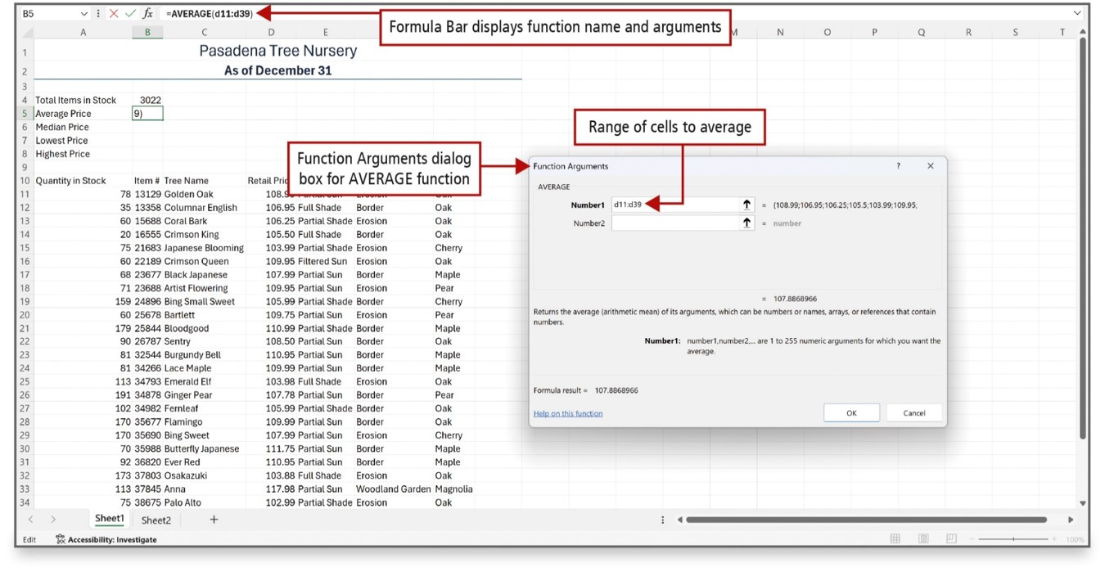
Use Flash Fill and the SUM, AVERAGE, MEDIAN, MIN, and MAX Functions (4 of 5)
Notes:
The Function Arguments dialog box allows you to enter the arguments for the function. The AVERAGE function, as shown here, requires a range of cells. The MEDIAN function also requires a range of cells.
Long Description:
The formula in the formula bar reads, equals AVERAGE open parenthesis d 11 is to d 39 close parenthesis in the formula bar. The corresponding callout reads, Formula Bar displays function name and arguments. The Function Arguments dialog box for AVERAGE function has dropdowns labeled Number 1 and Number 2. A callout pointing to the dialog box reads, Function Arguments dialog box for AVERAGE function. The last callout pointing to Number 1 reads, Range of cells to average.

Slide 8
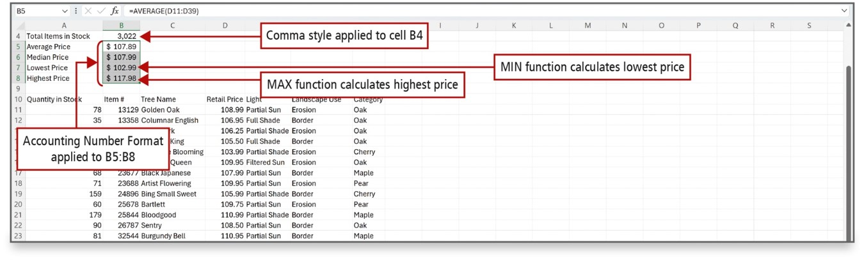
Use Flash Fill and the SUM, AVERAGE, MEDIAN, MIN, and MAX Functions (5 of 5)
Notes:
The MIN function determines the smallest value in a selected range of values.
The MAX function determines the largest value in a selected range of values.
The function results can be formatted using an appropriate format. In this case, the Accounting format is applied.
Long Description:
A small table on top has values for Total Items in Stock, Average Price, Median Price, Lowest Price, and Highest Price. A table below has columns for Quantity in Stock, Item number, Tree Name, Retail Price Light, Landscape Use, and Category. The callouts pointing to different elements are as follows: the value 3,022 for Total Items in Stock: Comma style applied to cell B 4; the values for the consecutive prices: Accounting Number Format applied to B 5 is to B 8; the minimum value for Lowest Price: MIN function calculates lowest price; the maximum value for Highest Price: MAX function calculates highest price.

Slide 9
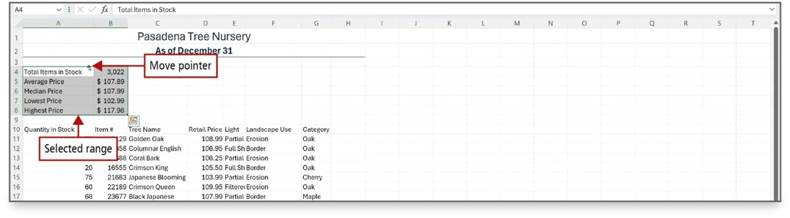
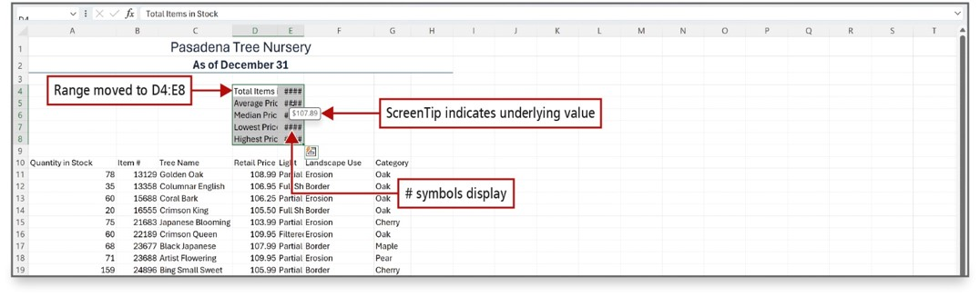
Move Data, Resolve Error Messages, and Rotate Text (1 of 2)
Notes:
When you move a formula, the cell references within the formula do not change, no matter what type of cell reference you use. An easy way to move a range of cells is to use drag and drop.
If you move cells that are not wide enough to display number values, a message is displayed so you can adjust as necessary.
If a cell width is too narrow to display the entire number, Excel displays the #### message.
Long Description 1:
A small table on top has values for Total Items in Stock, Average Price, Median Price, Lowest Price, and Highest Price. A table below has columns for Quantity in Stock, Item number, Tree Name, Retail Price Light, Landscape Use, and Category. A pointer appears next to Total Items in Stock as a double-headed arrow with a vertical bar in the center. A callout pointing to the pointer reads, Move pointer. The small table is selected. A callout pointing to the table selection layout reads, Selected range. \
Long Description 2:
The sheet has a small table selected with a range from D 4 to E 8. A table for tree categories is below. A ScreenTip appears over an entry of hashes for the moved table and it reads as 107.89 dollars. The callouts are as follows: the range from D 4 to E 8: Range moved to D 4 colon E 8; numbers in the moved table displayed as hash symbols: hash symbols display; a ScreenTip over an entry of hashes: ScreenTip indicates underlying value.

Slide 10
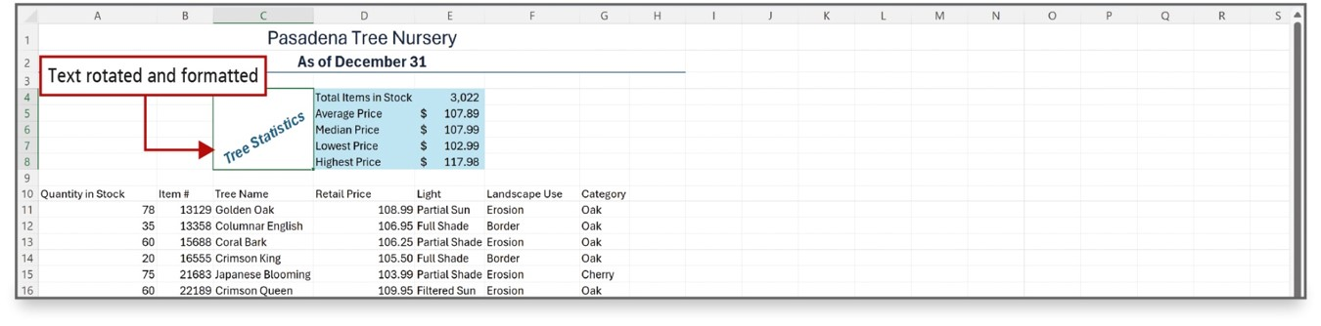
Move Data, Resolve Error Messages, and Rotate Text (2 of 2)
Notes:
Text can be rotated in a worksheet. In this example, in cell C6, the font size and color were changed and bold and italic were added. Range C4:C8 was merged and then rotated in the Format Cells dialog box, which is accessed from the shortcut menu.

Slide 11
Use COUNTIF and IF Functions and Apply Conditional Formatting (1 of 7)
Logical function—tests for specific conditions
Criteria—specific conditions that are true or false
COUNT function—counts the number of cells in a range containing numbers
COUNTIF function—counts the number of cells within a range that meet the given criteria
Notes:
A logical function tests for specific conditions.
Criteria refers to the specific conditions that are true or false.
The COUNT function counts the number of cells in a range that contain numbers.
The COUNTIF function is a statistical function that counts the number of cells within a range that meet the given criteria.

Slide 12
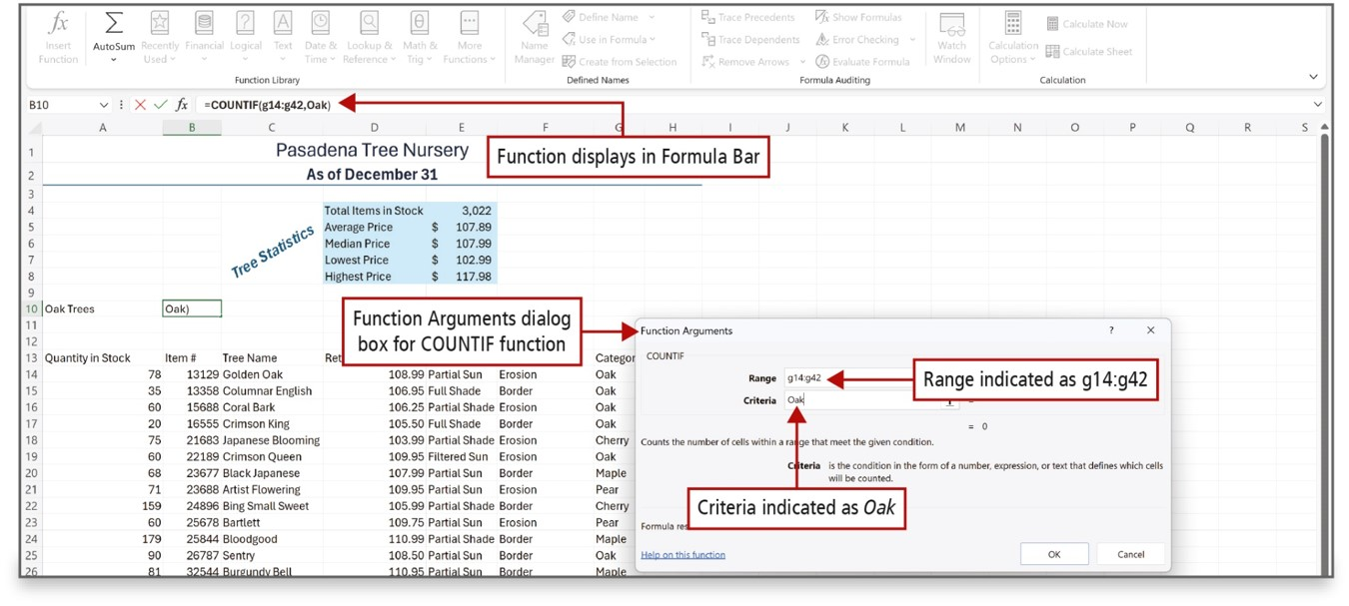
Use COUNTIF and IF Functions and Apply Conditional Formatting (2 of 7)
Notes:
The slide shows the Function Arguments dialog box for the COUNTIF function. A range of cells is selected, and criteria are entered for the function.
Long Description:
A callout for COUNTIF function in the formula bar reads, Function displays in Formula Bar. A callout for the Function Arguments dialog box reads, Function Arguments dialog box for COUNTIF function. The dialog box has fields for Range and Criteria. Range is set to g 14 is to g 42 and Criteria is set to Oak. The corresponding callouts are Range indicated as g 14 is to g 42 and Criteria indicated as Oak.

Slide 13
Use COUNTIF and IF Functions and Apply Conditional Formatting (3 of 7)
Logical test—any value or expression evaluated as true or false
IF function—uses a logical test to check whether a condition is met
Returns one value if true
Another value if false
Notes:
A logical test is any value or expression that is evaluated as being true or false.
The IF function uses a logical test to check whether a condition is met, and then returns one value if the condition is true, and another value if false.

Slide 14
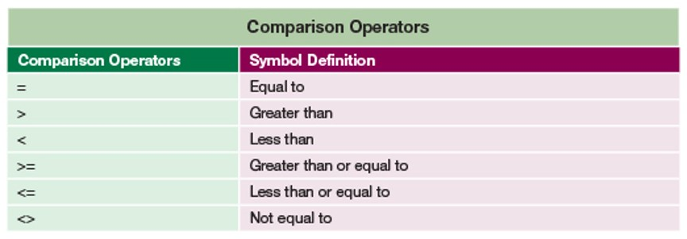
Use COUNTIF and IF Functions and Apply Conditional Formatting (4 of 7)
Notes:
Comparison operators are used to apply a logical test. The table shows the Excel comparison operators.
Long Description:
The table consists of 2 columns and 6 rows. The column headings are as follows: Column 1: Comparison Operators. Column 2: Symbol Definition. The row values are as follows: Row 1, Column 1: Equals. Row 1, Column 2: equal to. Row 2, Column 1: greater than symbol. Row 2, Column 2: greater than. Row 3, Column 1: Less than symbol. Row 3, Column 2: less than. Row 4, Column 1: Greater than or equals symbol. Row 4, Column 2: Greater than or equal to. Row 5, Column 1: Less than or equals symbol. Row 5, Column 2: Less than or equal to. Row 6, Column 1: Less than, greater than symbols. Row 6, Column 2: Not equal to.

Slide 15
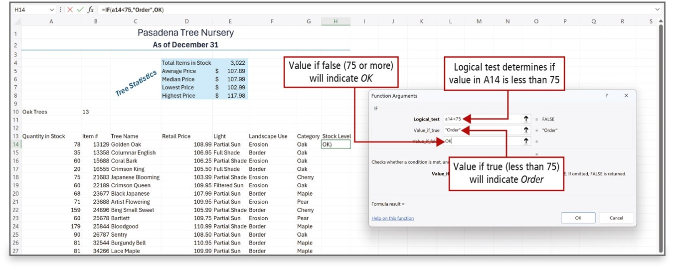
Use COUNTIF and IF Functions and Apply Conditional Formatting (5 of 7)
Notes:
The Function Arguments dialog box is used to create the IF function.
Long Description:
There are text fields for Logical underscore test, Value underscore if underscore true, and Value underscore if underscore false. The field Logical underscore test is set to a 14 is less than 75. The field Value underscore if underscore true is set to Order in quotes. The field Value underscore if underscore false is set to O K. The corresponding callouts are as follows: Logical test determines if value in A 14 is less than 75, Value if true (less than 75) will indicate order, and Value if false (75 or more) will indicate O K.

Slide 16
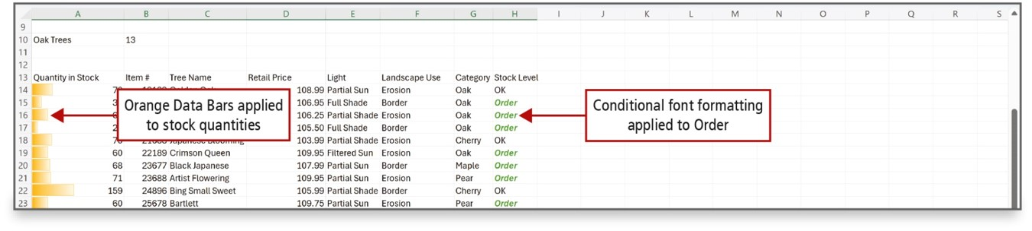
Use COUNTIF and IF Functions and Apply Conditional Formatting (6 of 7)
Notes:
A conditional format changes the appearance of a cell based on a condition—a criteria. If the condition is true, the cell is formatted based on that condition; if the condition is false, the cell is not formatted.
A data bar provides a visual cue to the reader about the value of a cell relative to other cells. The length of the data bar represents the value in the cell.
Long Description:
The table has columns such as Quantity in Stock, Item number, Tree Name, Retail Price, Light, Landscape Use, Category, and Stock Level. A callout pointing to the bars from A 14 to A 23 reads, Orange data bars are applied to stock quantities. A callout for the term Order under the section Stock Level reads, Conditional font formatting is applied to Order.

Slide 17
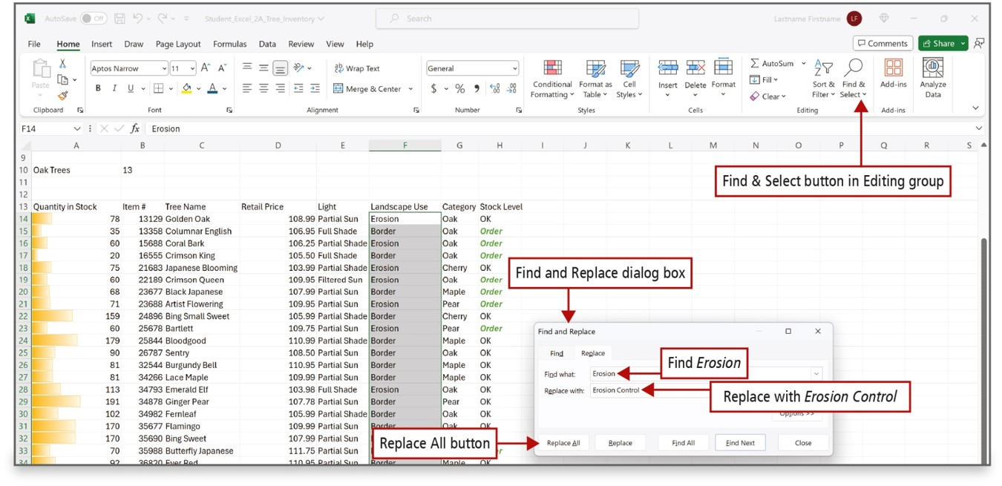
Use COUNTIF and IF Functions and Apply Conditional Formatting (7 of 7)
Notes:
The Find and Replace feature searches the cells in a worksheet—or in a selected range—for matches, and then replaces each match with a replacement value of your choice.
Long Description:
The sheet has a table for quantity stocks with bars in a column and the words Erosion and Border in another column that is selected. The Find and Select button in Editing group is annotated. The find and replace dialog box is annotated. The dialog box shows dropdowns for Find what and Replace with. Find what is set to Erosion, and the corresponding callout reads, Find Erosion. Replace with is set to Erosion Control. The Replace All button is annotated. The other buttons are Replace, Find All, Find Next, and Close.

Slide 18
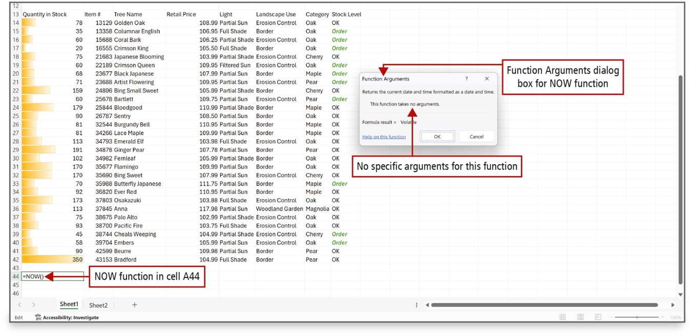
Use Date & Time Functions and Freeze Panes (1 of 2)
Notes:
Excel can obtain the date and time from your computer’s calendar and clock and display this information on your worksheet.
The NOW function retrieves the date and time from your computer’s calendar and clock and inserts the information into the selected cell.
Long Description:
The dialog box is labeled Functions Arguments dialog box for NOW function. Text in the box reads, Returns the current date and time formatted as a date and time. This function takes no arguments. A callout pointing to the second sentence reads, No specific arguments for this function. Cell A 44 is set to NOW function, and the corresponding callout reads, NOW function in cell A 44.

Slide 19
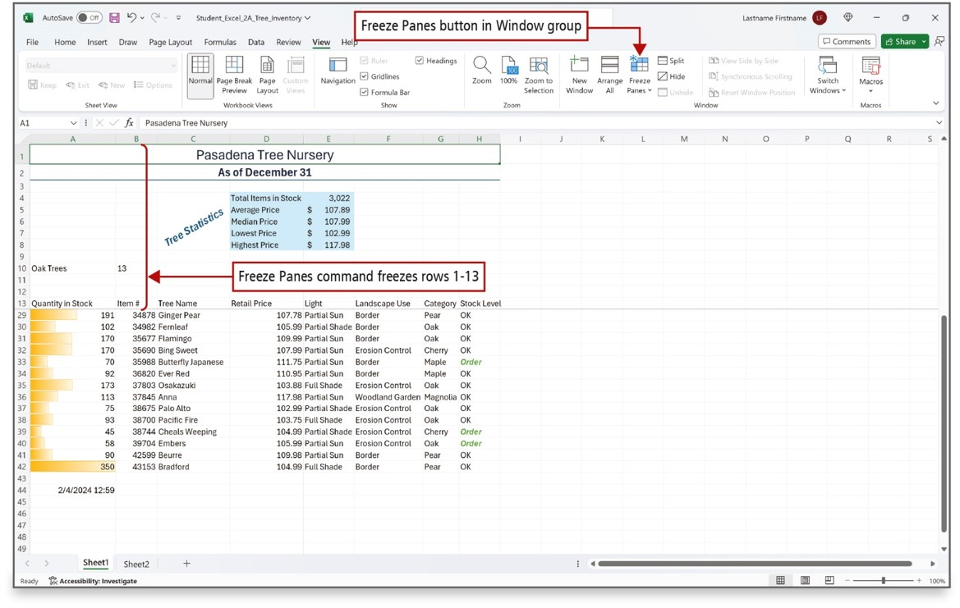
Use Date & Time Functions and Freeze Panes (2 of 2)
Notes:
The Freeze Panes command enables you to select one or more rows or columns and then freeze or lock them into place.
A pane is a portion of a worksheet window bounded by and separated from other portions by vertical or horizontal bars.

Slide 20
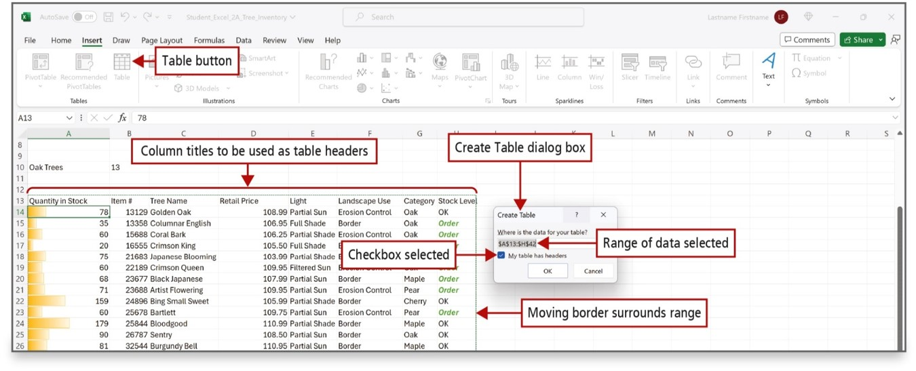
Create, Sort, and Filter an Excel Table (1 of 3)
Notes:
In order to analyze a group of related data, you convert a range of cells to an Excel table by selecting the range of cells that make up the table, including the header row, and clicking Table to display the Create Table dialog box.
An Excel table has a series of rows and columns that contains related data that is managed independently from the data in other rows and columns in the worksheet.
Long Description:
The Table button is annotated. The column titles of the table are to be used as table headers. The Create Table dialog box has a field with a range of cells entered and selected and a checked checkbox for My table has headers. The corresponding callouts are range of data selected and checkbox selected. A callout pointing to the border for the range that includes the table reads, The Moving border surrounds range.

Slide 21
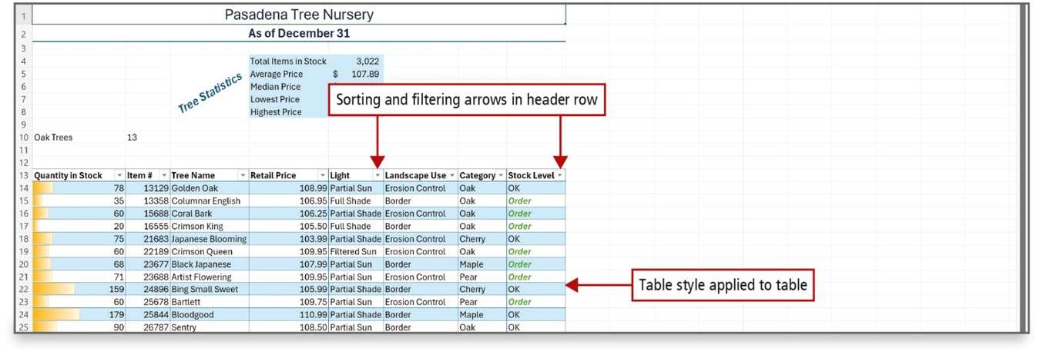
Create, Sort, and Filter an Excel Table (2 of 3)
Notes:
You can sort tables—arrange all the data in a specific order—in ascending or descending order.
A table can have a style applied, as shown in this worksheet.

Slide 22
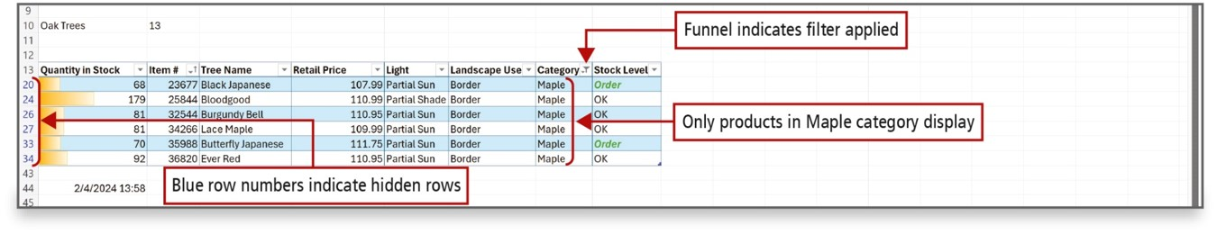
Create, Sort, and Filter an Excel Table (3 of 3)
Notes:
You can filter tables—display only a portion of the data based on matching a specific value—to show only the data that meets the criteria that you specify. When you are finished answering questions about the data in a table, you can clear the filters.
Long Description:
The table has some hidden rows from rows 13 to 20 and from rows 20 to 34. Funnel filter is applied to a column labeled Category. The column shows Maple as entries. The callouts are as follows: highlighted row numbers: Blue row numbers indicate hidden rows; Funnel filter: Funnel indicates filter applied; the selected column Category: Only products in Maple category display.

Slide 23
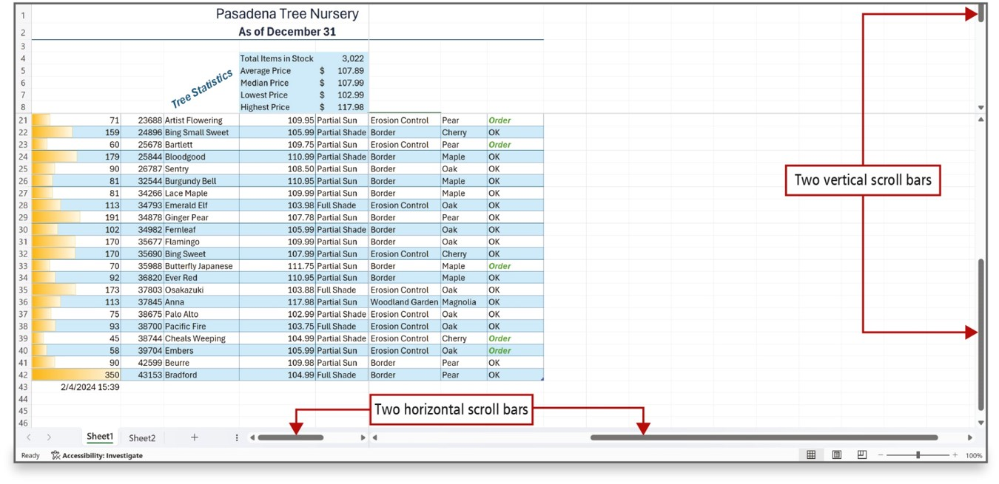
View, Format, and Print a Large Worksheet (1 of 2)
Notes:
You can magnify or shrink the view of a worksheet on your screen to either zoom in or zoom out. You can also split a worksheet window into panes. As you can see, vertical and horizontal split bars display when you split a window.

Slide 24
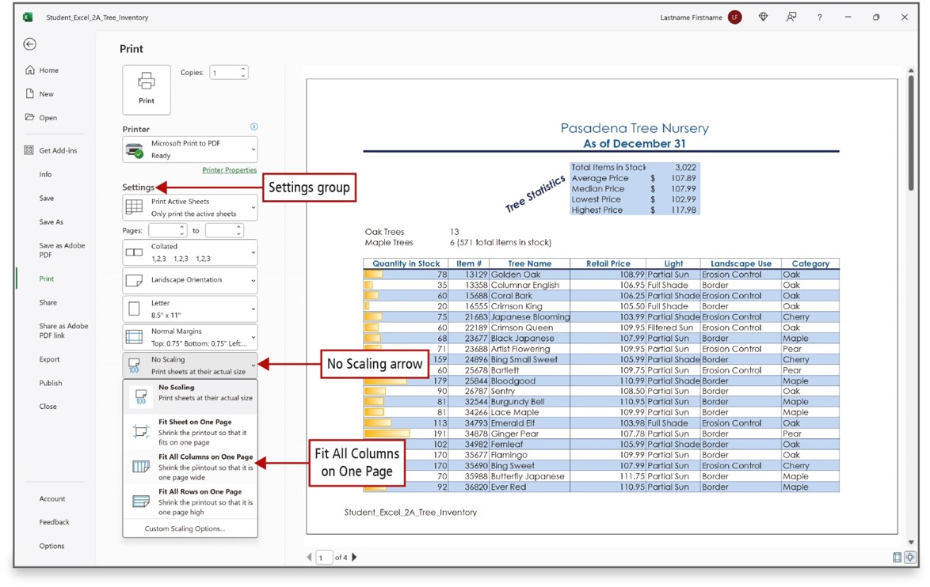
View, Format, and Print a Large Worksheet (2 of 2)
Notes:
Print settings that help you print a professional-looking large worksheet include:
Center on page command
Landscape orientation
Fit All Columns on One Page command
Print Titles command
If a worksheet is too wide, too long, or both to print on one page, Excel’s Print Titles and Scale to Fit commands can help you create pages that are attractive and easy to read.
Long Description:
The left pane has tabs such as Home, New, Open, Print (selected), and so on. In the Print page, it shows the Print icon and copies, the Printer field, and the Settings section. A table is on display on the right pane. The Settings section is labeled Settings group. No Scaling menu is selected under the Settings section. The arrow of the No Scale menu is labeled No Scaling arrow. The option Fit All Columns on One Page is selected and labeled.

Slide 25
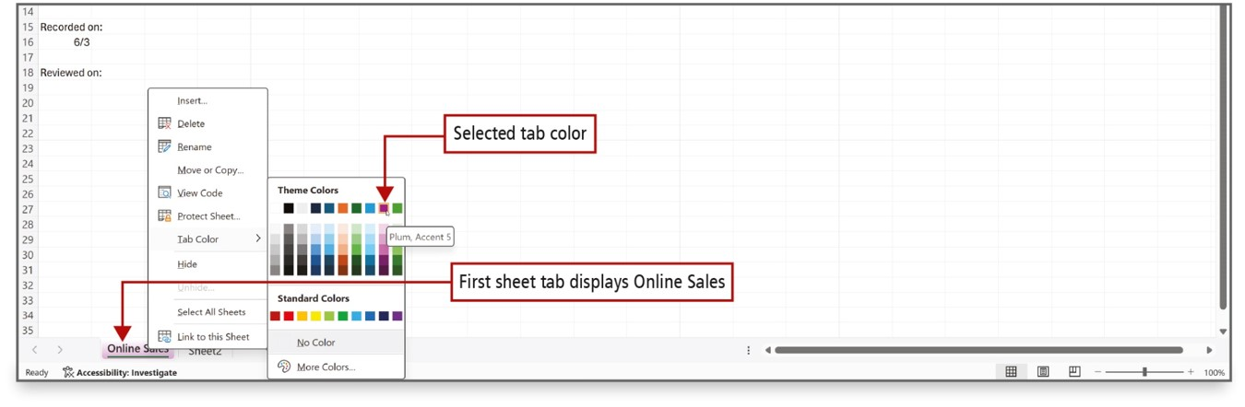
Navigate a Workbook and Rename Worksheets
Notes:
Use multiple worksheets in a workbook to organize data in a logical arrangement. When there is more than one worksheet in a workbook, you can navigate (move) among worksheets by clicking the sheet tabs.
Sheet tabs identify each worksheet in a workbook and display along the lower left edge of the workbook window. Sheet tab colors can also be changed. You can either double-click the sheet name or right-click the sheet name and use the shortcut menu to rename a sheet tab.
Long Description: The pop-up menu has options including Insert, Delete, Rename, Move or Copy, View Code, Protect Sheet, Tab Color, and Hide. The submenu has sections Theme Colors with a palette of colors and Standard Colors with a single row of colors and additional options such as No color and More colors. A callout pointing to a color box in the first row before the last one in the Theme Colors section reads, Selected tab color. A ScreenTip over it reads, Plum, Accent 5. A callout pointing to the Online Sales tab reads, First sheet tab displays Online Sales.

Slide 26
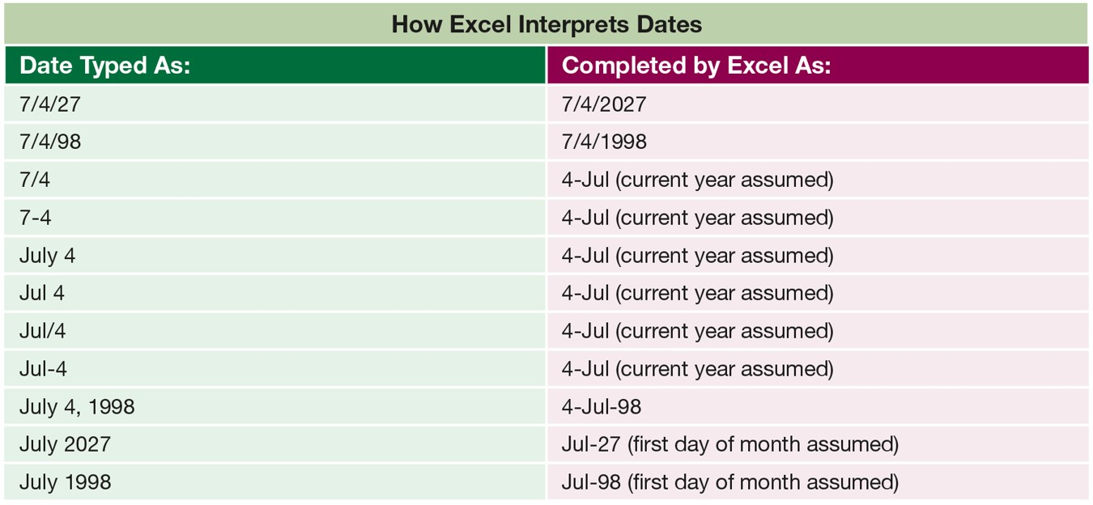
Enter Dates, Clear Contents, and Clear Formats (1 of 3)
Notes:
Dates represent a type of value that you can enter in a cell. When you enter a date, Excel assigns a serial value—a number—to the date. This makes it possible to treat dates like other numbers and use them in calculations.
The table illustrates how Excel interprets dates as they are entered. For example, Excel interprets either a dash or a slash as a separator between month and day.
Long Description:
The table consists of 2 columns and 11 rows. The column headings are as follows: Column 1: Date Typed as. Column 2: Completed by Excel as. The row values are as follows: Row 1, Column 1: 7 slash 4 slash 27. Row 1, Column 2: 7 slash 4 slash 2027. Row 2, Column 1: 7 slash 4 slash 98. Row 2, Column 2: 7 slash 4 slash 1998. Row 3, Column 1: 7 slash 4. Row 3, Column 2: 4 - July (current year assumed). Row 4, Column 1: 7 hyphen 4. Row 4, Column 2: 4 - July (current year assumed). Row 5, Column 1: July 4. Row 5, Column 2: 4 - July (current year assumed). Row 6, Column 1: Jul 4. Row 6, Column 2: 4 - July (current year assumed). Row 7, Column 1: Jul slash 4. Row 7, Column 2: 4 - July (current year assumed). Row 8, Column 1: Jul hyphen 4. Row 8, Column 2: 4 - July (current year assumed). Row 9, Column 1: July 4, 1998. Row 9, Column 2: 4 - July - 98. Row 10, Column 1: July 2027. Row 10, Column 2: July - 27 (first day of month assumed). Row 11, Column 1: July 1998. Row 11, Column 2: July - 98 (first day of month assumed).

Slide 27
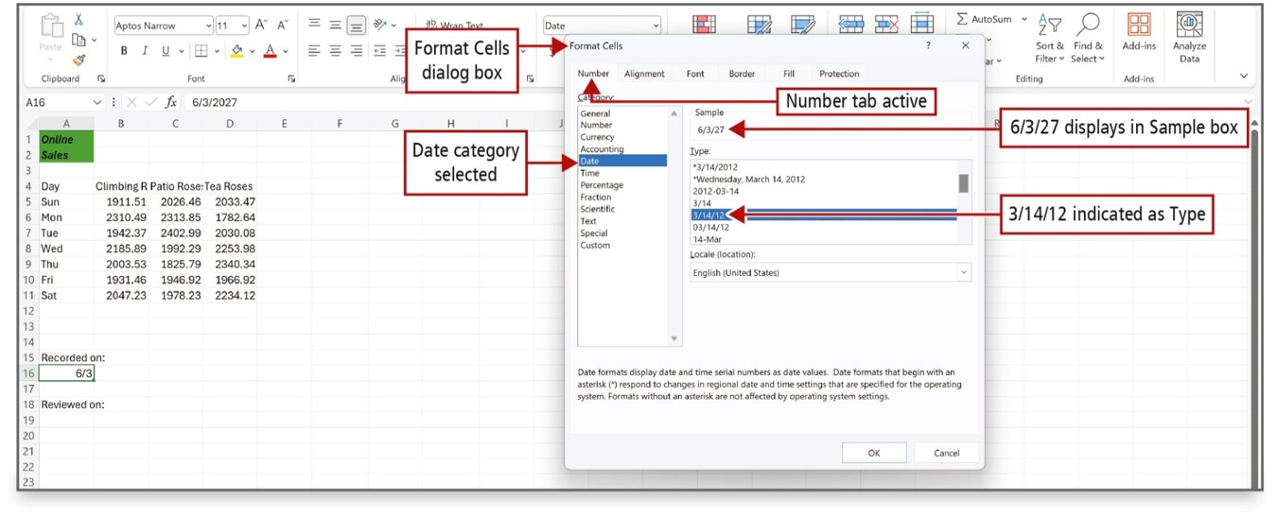
Enter Dates, Clear Contents, and Clear Formats (2 of 3)
Notes:
You can choose a date format on the Number tab of the Format Cells dialog box.
Long Description:
The Format Cells dialog box is labeled. There are tabs such as Number (selected), Alignment, Font, Border, Fill, and Protection. The Number tab has the Category list box on the left. A callout pointing to the Number tab reads, Number tab active. The options in the Category list box are General, Number, Currency, Accounting, Date (selected), Time, and so on. The Sample text field, a list box for Type, and a dropdown for Locale (location) are on the right. A callout pointing to Date reads, Date category selected. A callout pointing to the date in the Sample text field reads, 6 slash 3 slash 27 displays in Sample box. Another callout pointing to the selected date in the Type list box reads, 3 slash 14 slash 12 indicated as Type.

Slide 28
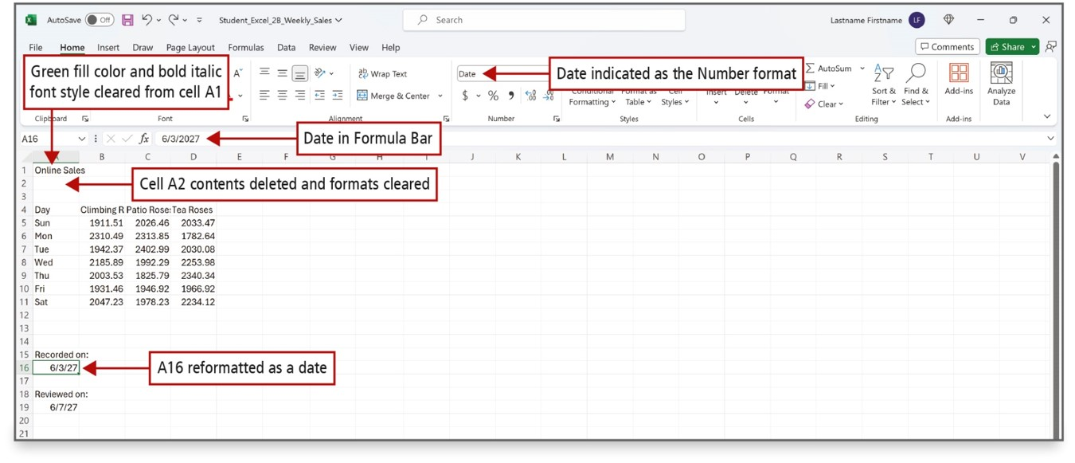
Enter Dates, Clear Contents, and Clear Formats (3 of 3)
Notes:
A cell has contents—a value or a formula—and a cell may also have one or more formats applied, for example, bold and italic font styles, fill color, font color, and so on.
You can choose to clear—delete—the contents of a cell, the formatting of a cell, or both.
Clearing the contents of a cell deletes the value or formula typed there, but it does not clear formatting applied to a cell.
Long Description:
A 1 has the entry as Online Sales. Rows 2 and 3 are empty. A table for roses for Sun to Sat is from A 4 to D 11. A 15 is set to Recorded on colon. A 16 has a date. A 18 is set to Reviewed on colon and A 19 is set to a date. The formula bar has the date 6 slash 3 slash 27. The callouts pointing to different elements are as follows: cell A 1: Green fill color and bold italic font style are cleared from cell A 1; cell A 2: Cell A 2 contents deleted and formats cleared; the date in A 16: A 16 reformatted as a date; the formula bar: Date in Formula Bar; a field set to Date in the Number group: Date indicated as the Number format.

Slide 29
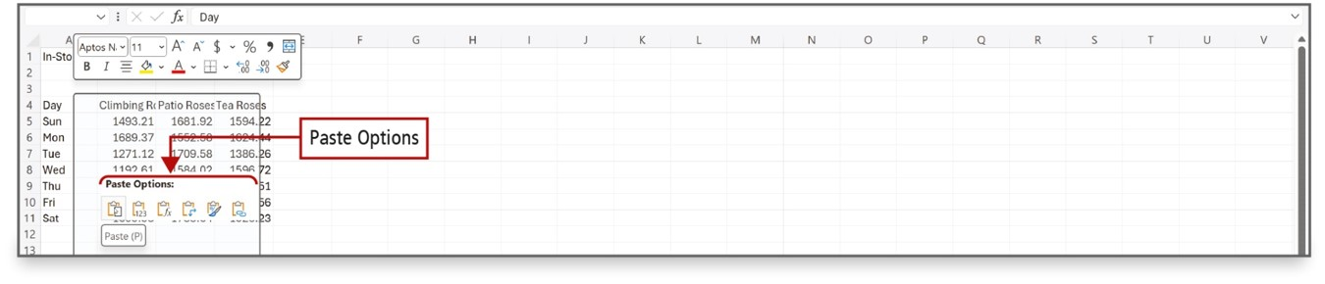
Copy and Paste by Using the Paste Options Gallery
Notes:
Data in cells can be copied to other cells. When you paste data to another cell, the Paste Options gallery displays, which includes Live Preview to preview the Paste formatting that you want.
Live Preview displays how the copied cells will be placed in the worksheet if you select the Paste button. You can experiment with different paste options to be sure you get the result that you want. When pasting a range of cells, you need only point to or select the cell in the upper left corner of the paste area—the target destination for data that has been cut or copied using the Clipboard.
Long Description:
The paste options are displayed in a mini tool bar across the Thu row under the selected column headers such as Climbing R, Patio Roses, and Tea Roses. The mini tool bar titled Paste options has icons for different paste options. A ScreenTip over the first icon reads, Paste (P).

Slide 30
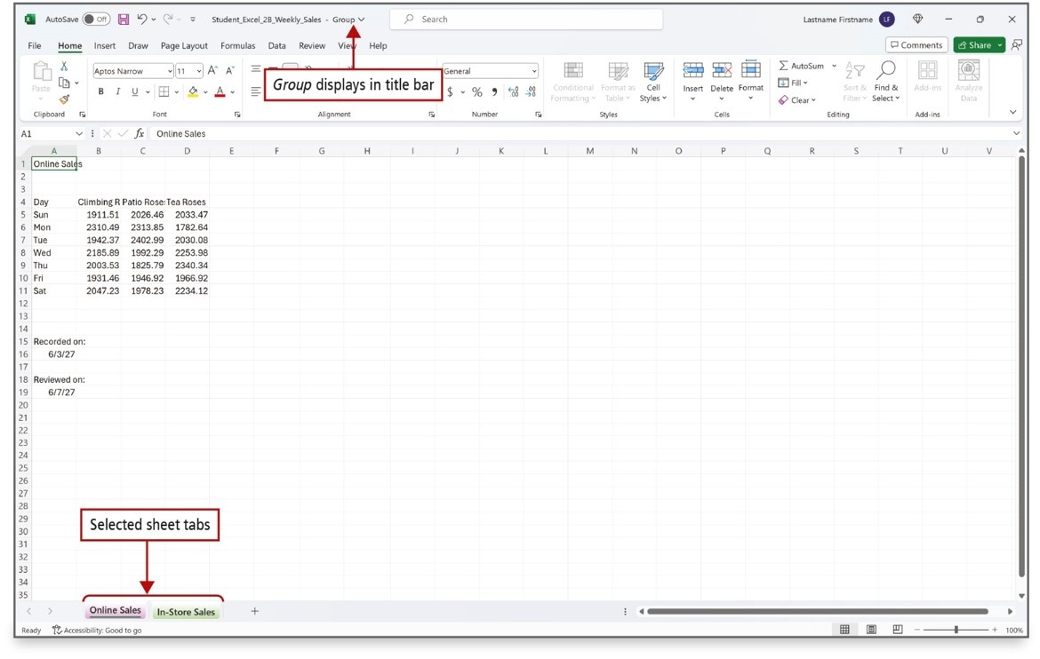
Edit and Format Multiple Worksheets at the Same Time (1 of 2)
Notes:
You can enter or edit data on several worksheets at the same time by grouping the worksheets. Data that you enter or edit on the selected sheet is reflected on all of the grouped sheets.
If the sheet tab displays with a solid background color, you know the sheet is not selected. If you see Group in the title bar and tab names are underlined, those sheets have been grouped.

Slide 31
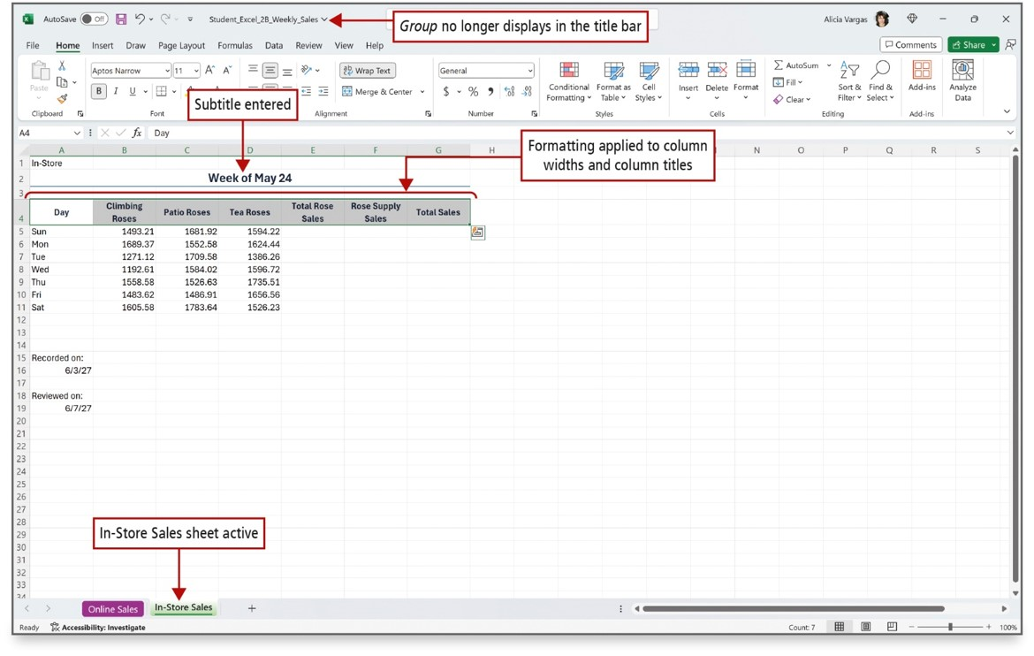
Edit and Format Multiple Worksheets at the Same Time (2 of 2)
Notes:
Formulas, formatting, and styles in this workbook were applied to several worksheets at the same time by grouping the sheets. When you are finished, right-click a sheet tab, and on the shortcut menu, select Ungroup Sheets.
Long Description:
The table has data for roses for Sun to Sat. The subtitle is Week of May 24. The column headers are Day, Climbing Roses, Patio Roses, Tea Roses, Rose Supply Sales, and Total Sales. The callouts are as follows: the title bar with no group displayed: Group no longer displays in the title bar; the subtitle in cells merged from A 2 to G 2: Subtitle entered; the selected column headers: Formatting applied to column widths and column titles; the selected sheet tab In-Store Sales: Instore Sales sheet active.

Slide 32
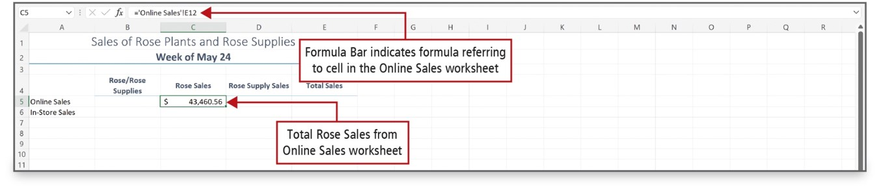
Create a Summary Sheet with Column Sparklines (1 of 3)
Notes:
A summary sheet is a worksheet where totals from other worksheets are displayed and summarized. This summary sheet uses formulas constructed from other sheets in the workbook, known as the detail sheets. The figure shows the data from the detail sheet named Online Sales being used in a summary sheet. Notice that in the formula the worksheet name is surrounded by apostrophes followed by an exclamation point.
Long Description:
The sheet has a title and a subtitle followed by columns such as blank, Roses slash Rose Supplies, Rose Sales, Rose Supply Sales, and Total Sales. There are two rows with the entries Online Sales and In-Store Sales under the blank column. The formula bar shows the worksheet name Online Sales and cell E 12. The corresponding label reads, Formula bar indicates formula referring to cell in the Online Sales worksheet. The data for Online Sales under the column Rose Sales: Total Rose Sales from Online Sales worksheet.

Slide 33
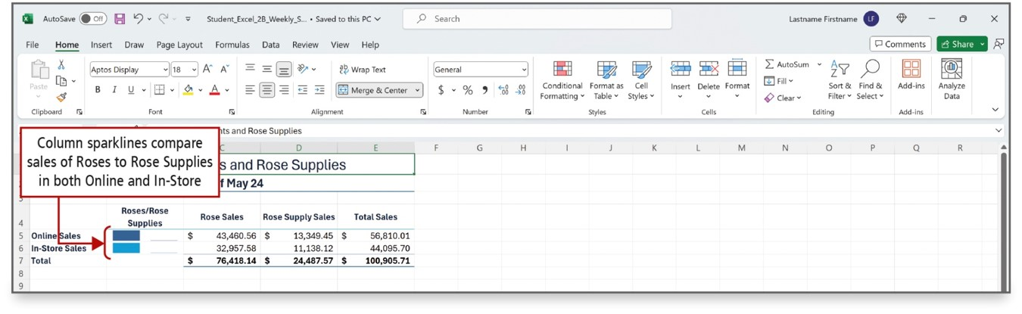
Create a Summary Sheet with Column Sparklines (2 of 3)
Notes:
Sparklines are tiny charts within a single cell that show a data trend. Sparklines are created using the Create Sparklines dialog box.
The summary sheet displays Column Sparklines that demonstrate that for both Online and In-Store sales, Rose Sales are greater than Rose Supply Sales.
Long Description:
The sheet has a title and a subtitle followed by columns such as blank, Roses slash Rose Supplies, Rose Sales, Rose Supply Sales, and Total Sales. There are three row titles Online Sales, In-Store Sales, and Total under the blank column. A callout corresponding to the horizontal bars and lines in cells B 5 and B 6 reads, Column sparklines compare sales of Roses to Rose Supplies both Online and In-Store.

Slide 34
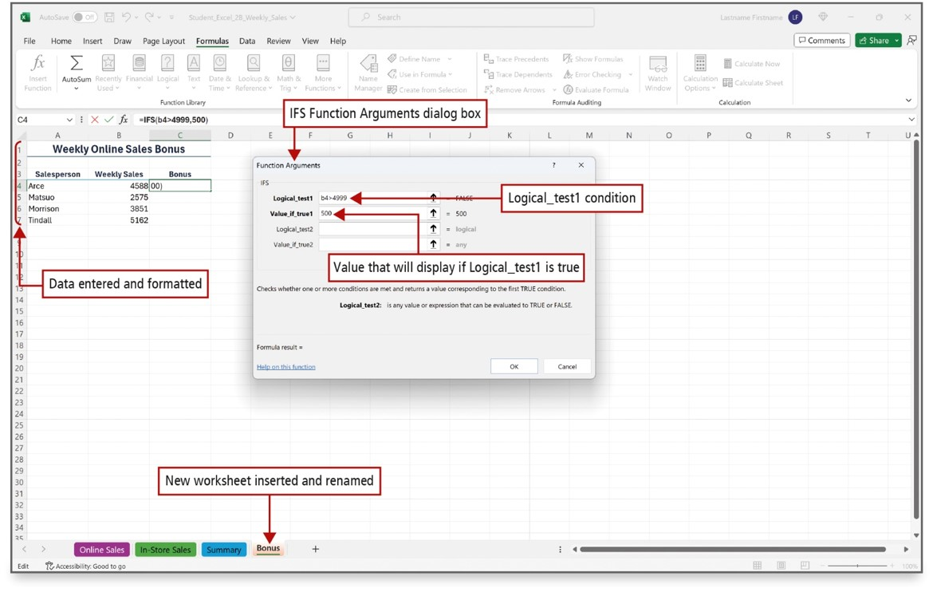
Create a Summary Sheet with Column Sparklines (3 of 3)
Notes:
The IFS function checks whether one or more conditions—logical tests—are met, and then returns a value corresponding to the first TRUE condition.
This example of the IFS function contains four logical tests, displayed in the formula bar. It is important to include a default value that displays if none of the conditions are met. When no default value is included, an error message displays if no TRUE conditions are found. In this case, the default value is 0.
Long Description:
A callout pointing to rows 1 to 7 of the table reads, Data entered and formatted. The Function Arguments dialog box is open and the corresponding callout reads, I F S Function Arguments dialog box. The dialog box has text fields for Logical underscore test 1, Value underscore if underscore true 1, Logical underscore test 2, and Value underscore if underscore true 2. Logical underscore test 1 is set to b 4 greater than 4999. The corresponding callout reads, Logical underscore test 1 condition. Value underscore if underscore true 1 is set to 500. The corresponding callout reads, Value that will display if Logical underscore test 1 is true. A callout pointing to the Bonus sheet tab reads, New worksheet inserted and renamed.

Slide 35
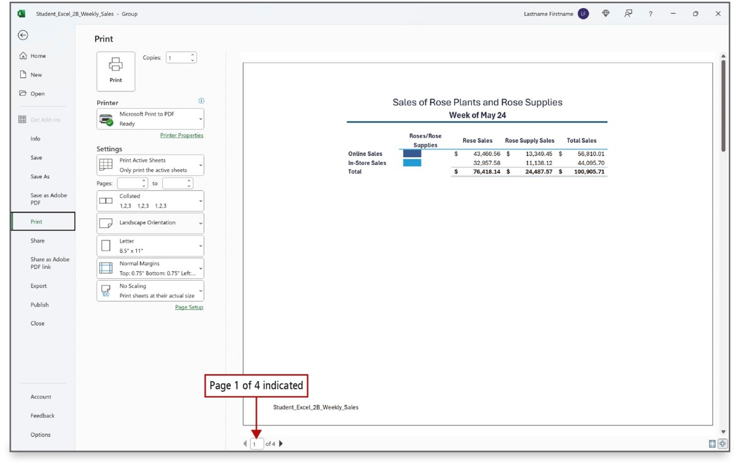
Format and Print Multiple Worksheets in a Workbook
Notes:
By selecting more than one worksheet, you can apply the same formatting to all the worksheets at the same time; for example, to repeat headers or footers. You can also group worksheets to print several sheets at one time. In Print Preview, the number of pages that will print is indicated at the bottom of the window, as shown here. You can drag a worksheet to a new location. The summary sheet has been moved to be the first worksheet in the workbook and displays as page 1 of 4.
Long Description:
The left pane has tabs such as Home, New, Open, Print (selected), and so on. The Print page has the Print icon, copies, the Printer selection, printer settings, and print layouts. The preview of the table is on the right. A callout pointing to the page number on the status bar reads, Page 1 of 4 indicated.

Slide 36

Questions

Slide 37

Copyright
This work is protected by United States copyright laws and is provided solely for the use of instructors in teaching their courses and assessing student learning. Dissemination or sale of any part of this work (including on the World Wide Web) will destroy the integrity of the work and is not permitted. The work and materials from it should never be made available to students except by instructors using the accompanying text in their classes. All recipients of this work are expected to abide by these restrictions and to honor the intended pedagogical purposes and the needs of other instructors who rely on these materials.

